Slide 1


Passport – Jwt JSON Web Token
JavaScript Runtime
On Server Side

Slide 2
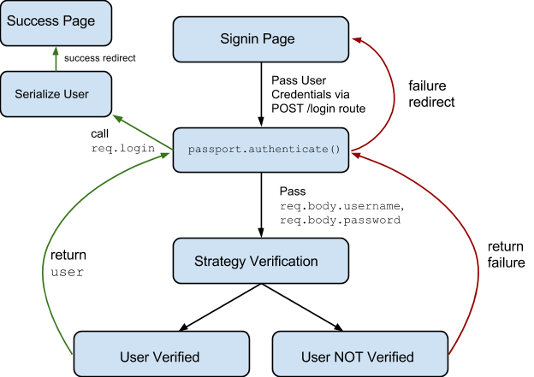
Quá trình xác thực – Passport.js

Slide 3
Passport – jwt
A Passport strategy for authenticating with a JSON Web Token.
This module lets you authenticate endpoints using a JSON web token. It is intended to be used to secure RESTful endpoints without sessions.

Slide 4
Cài đặt
npm install passport-jwt

Slide 5
Cách sử dụng
Configure Strategy
new JwtStrategy(options, verify)
options is an object literal containing options to control how the token is extracted from the request or verified
verify is a function with the parameters verify(jwt_payload, done)
Extracting the JWT from the request
fromHeader(header_name)
fromBodyField(field_name)
fromAuthHeaderWithScheme(auth_scheme)

Slide 6
Example
http://www.passportjs.org/packages/passport-jwt/

Slide 7
References
https://jwt.io/
http://www.passportjs.org/packages/passport-jwt/

